Slide 1
efficiency
Human computer interaction

Slide 2
Topics
Human information processing
Pointing and steering
  Fitts’s Law
Shortcuts
Keystroke level Model
Notes:
Note that when we say efficiency, we’re not concerned with the performance of the backend, or choices of algorithms or data structures, or analyzing or proving their performance. Those are important questions, but you can take other courses about answering them. We’re concerned with the channel between the user and the system; how quickly can we get instructions and information across that interface? In other words, assuming that the user interface is the performance bottleneck, how fast can the whole system go?

Slide 3
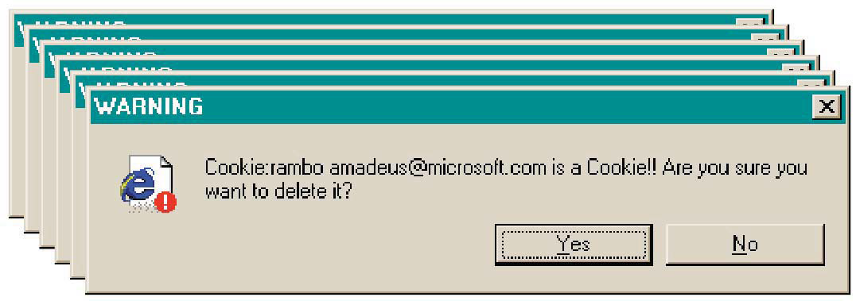
Efficiency Hall of Shame

Slide 4
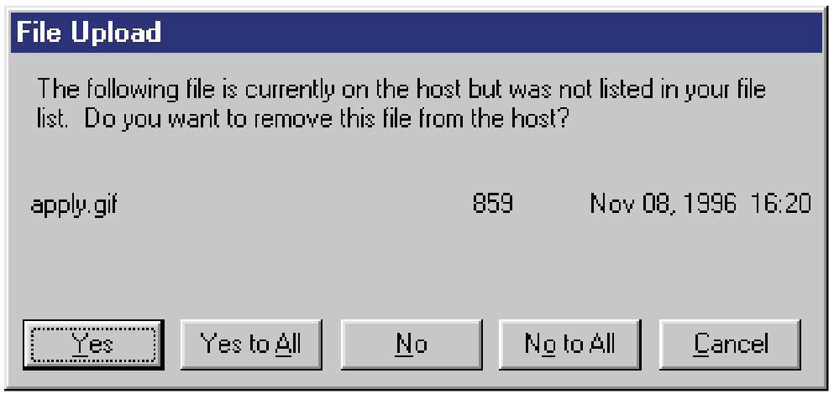
Efficiency Hall of Fame or Shame?

Slide 5
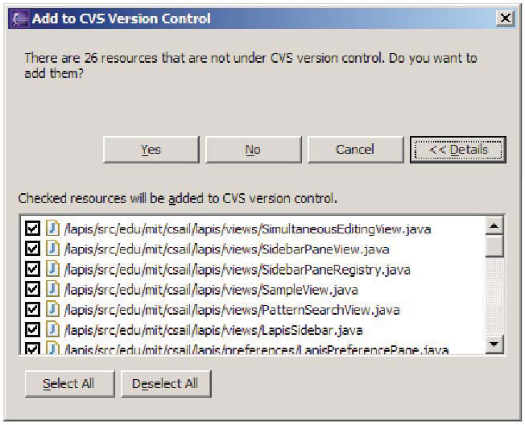
Efficiency Hall of Fame

Slide 6
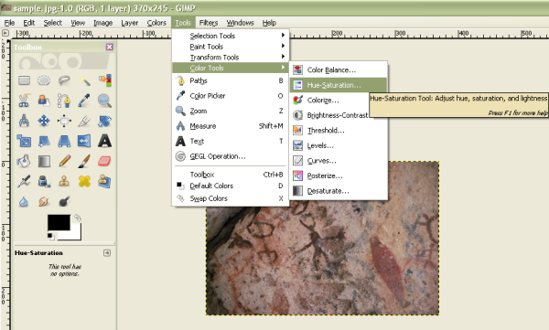
An interface with no shortcuts

Slide 7
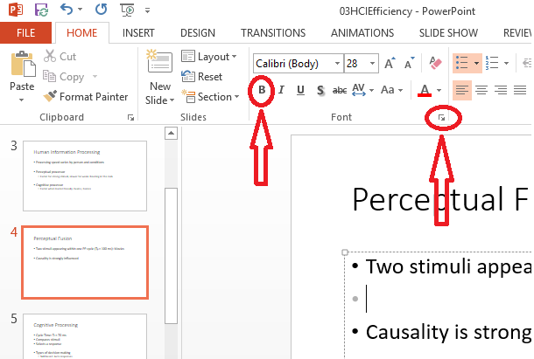
Which one is easy to point

Slide 8
Human information processor

Slide 9
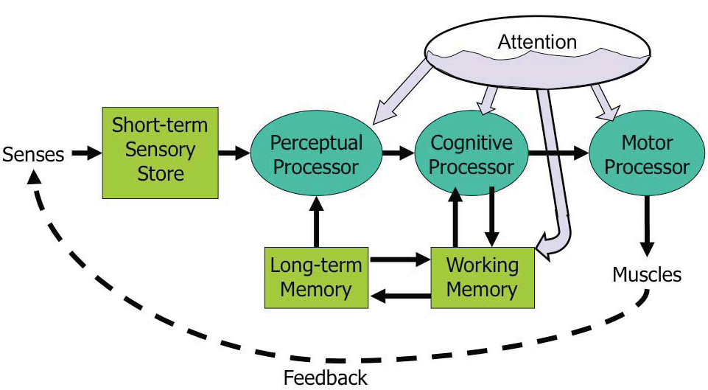
Human Information Processing
Model Human Processor (MHP)
Notes:
This model is an abstraction, of course. But it’s an abstraction that actually gives us numerical parameters describing how we behave. Just as a computer has memory and processor, so does our model of a human. Actually, the model has several different kinds of memory, and several different processors.
Input from the eyes and ears is first stored in the short-term sensory store. As a computer hardware analogy, this memory is like a frame buffer, storing a single frame of perception.
The perceptual processor takes the stored sensory input and attempts to recognize symbols in it: letters, words, phonemes, icons. It is aided in this recognition by the long-term memory, which stores the symbols you know how to recognize.
The cognitive processor takes the symbols recognized by the perceptual processor and makes comparisons and decisions. It might also store and fetch symbols in working memory (which you might think of as RAM, although it’s pretty small). The cognitive processor does most of the work that we think of as “thinking”.
The motor processor receives an action from the cognitive processor and instructs the muscles to execute it. There’s an implicit feedback loop here: the effect of the action (either on the position of your body or on the state of the world) can be observed by your senses, and used to correct the motion in a continuous process.
Finally, there is a component corresponding to your attention, which might be thought of like a thread of control in a computer system.
Note that this model isn’t meant to reflect the anatomy of your nervous system. There probably isn’t a single area in your brain corresponding to the perceptual processor, for example. But it’s a useful abstraction nevertheless.

Slide 10
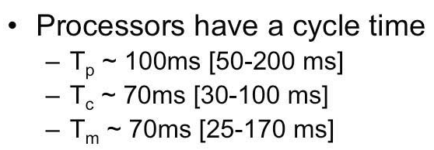
Processors
Cycle time is the time needed to accept one input and produce one output
Processing speed varies by person and conditions
Perceptual processor
  Faster for strong stimuli, slower for week: Reading in the dark
Cognitive processor
  Faster when loaded heavily: Exams, Games

Slide 11
Perceptual Processing
Cycle Time: T_{p} ≈ 100 ms
Organizes stimuli
Creates a scene
Perceptual Fusion
  Two stimuli appearing within one PP cycle (T_{p} ≈ 100 ms): Movies
  Causality is strongly influenced (e.g. glass breaking)
Notes:
We’ve already encountered one interesting effect of the perceptual processor: perceptual fusion. Here’s an intuition for how fusion works. Every cycle, the perceptual processor grabs a frame (snaps a picture). Two events occurring less than the cycle time apart are likely to appear in the same frame. If the events are similar – e.g., Mickey Mouse appearing in one position, and then a short time later in another position – then the events tend to fuse into a single perceived event – a single Mickey Mouse, in motion. Fusion also strongly affects our perception of causality. If one event is closely followed by another – e.g., pressing a key and seeing a change in the screen – and the interval separating the events is less than Tp, then we are more inclined to believe that the first event caused the second.

Slide 12
Cognitive Processing
Cycle Time: T_{c} ≈ 70 ms
Compares stimuli (comparisons)
Selects a response (decisions)
Types of decision making
  Skill based
    Skill is a procedure that has been leaned thoroughly from practice; walking talking, pointing, reading, driving etc.
    Automatic responses that Require little or no attention: cutting vegetables
  Rule based
    Consciously processing a set of rules of the form if X, then do Y
    Typically made by novices or occasional performers of a task
    Learner driving: is there a sign, is there a car in left side etc.
    With practice the rules become skills
  Knowledge based
    To handle unfamiliar or unexpected problems: New software, car not starting etc.
Efficiency is most important for well-learned procedures
Notes:
The cognitive processor is responsible for making comparisons and decisions. Cognition is a rich, complex process. The best-understood aspect of it is skill-based decision making. A skill is a procedure that has been learned thoroughly from practice; walking, talking, pointing, reading, driving, typing are skills most of us have learned well. Skill-based decisions are automatic responses that require little or no attention. Since skill-based decisions are very mechanical, they are easiest to describe in a mechanical model like the one we’re discussing. Two other kinds of decision making are rule-based, in which the human is consciously processing a set of rules of the form if X, then do Y; and knowledge-based, which involves much higher-level thinking and problem-solving. Rule-based decisions are typically made by novices or occasional performers of a task. When a student driver approaches an intersection, for example, they must think explicitly about what they need to do in response to each possible condition (“is there a stop sign? Are there other cars arriving at the intersection? Who has the right of way?”). With practice, the rules become skills, and you don't think about how to do them anymore. Knowledge-based decision making is used to handle unfamiliar or unexpected problems, such as figuring out why your car won’t start.

Slide 13
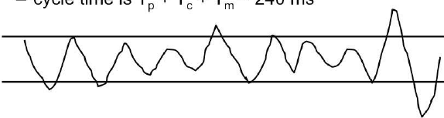
Motor Processing
Motor processor can operate in two ways
Open Loop Control
  Not dependent on feedback, motor processor runs by itself
  Cycle time: T_{m} ≈ 70 ms
Closed Loop Control
  Depends upon the feedback: perceived and decision made about adjustment
    Cycle time: T_{p} + T_{c} + T_{m} ≈ 240 ms
Draw a sawtooth wave between two parallel lines for 5 seconds
  Frequency of wave is dictated by open-loop control (T_{m} )
  Frequency of corrections is closed-loop control (T_{p} + T_{c} )
Notes:
The motor processor can operate in two ways. It can run autonomously, repeatedly issuing the same instructions to the muscles. This is “open-loop” control; the motor processor receives no feedback from the perceptual system about whether its instructions are correct. With open loop control, the maximum rate of operation is just Tm. The other way is “closed-loop” control, which has a complete feedback loop. The perceptual system looks at what the motor processor did, and the cognitive system makes a decision about how to correct the movement, and then the motor system issues a new instruction. At best, the feedback loop needs one cycle of each processor to run, or Tp + T c + T m ~ 240 ms.
Here’s a simple but interesting experiment that you can try: take a sheet of lined paper and scribble a sawtooth wave back and forth between two lines, going as fast as you can but trying to hit the lines exactly on every peak and trough. Do it for 5 seconds. The frequency of the sawtooth carrier wave is dictated by open-loop control, so you can use it to derive your Tm. The frequency of the wave’s envelope, the corrections you had to make to get your scribble back to the lines, is closed-loop control. You can use that to derive your value of Tp + T c.

Slide 14
Shortcuts

Slide 15
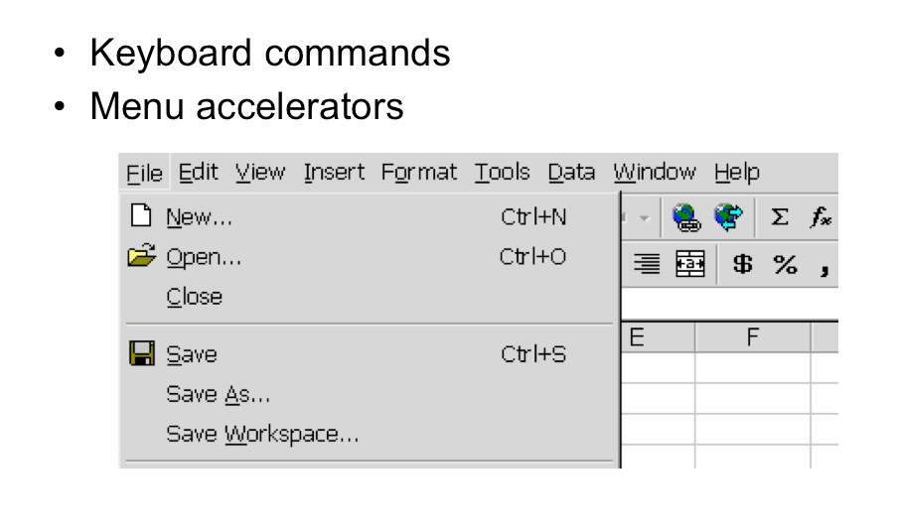
Keyboard Shortcuts
Notes:
Menubars and buttons often have accelerators as well (the underlined letters, which are usually invoked by holding down Alt to give keyboard focus to the menubar, then pressing the underlined letter)

Slide 16
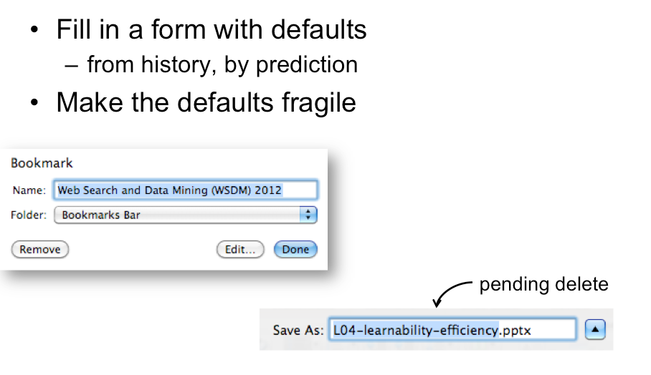
Defaults and Pending deletes
Notes:
Defaults are common answers already filled into a form. Defaults should be fragile; when you click on or Tab to a field containing a default value, it should be fully selected
technique, where typing replaces the selection, is called pending delete

Slide 17
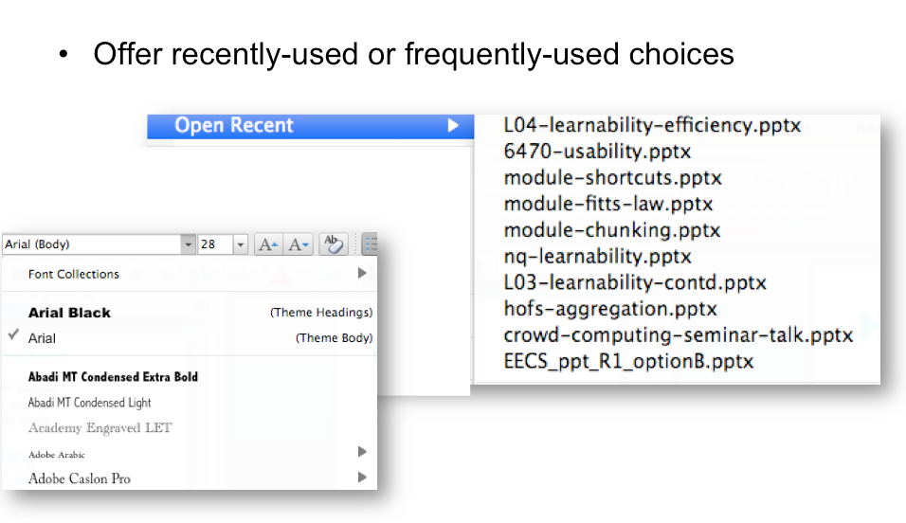
History

Slide 18
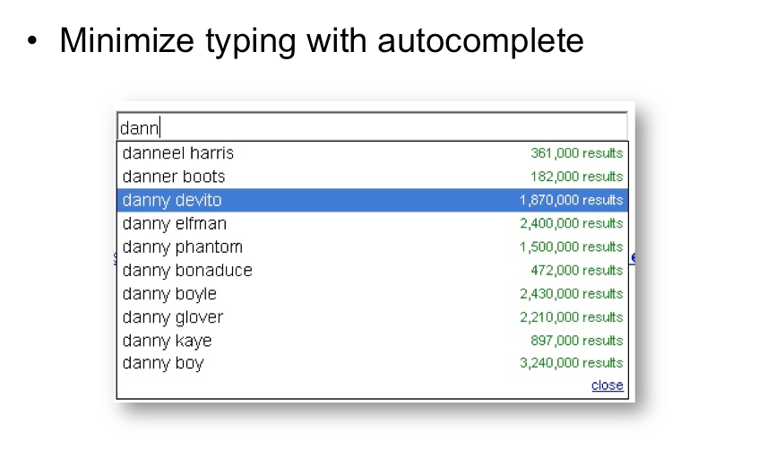
Autocomplete

Slide 19
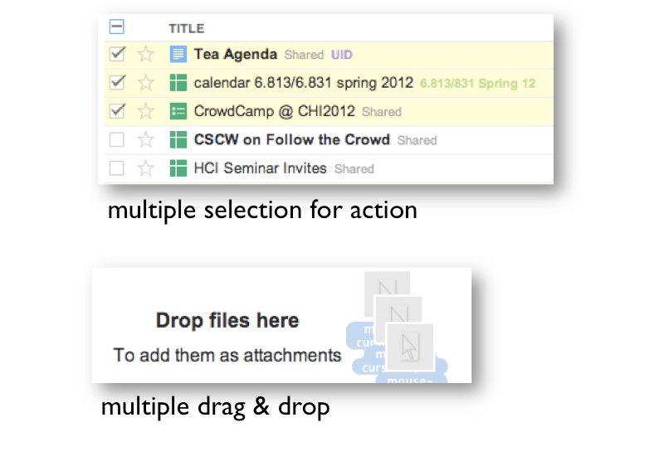
Aggregation

Slide 20
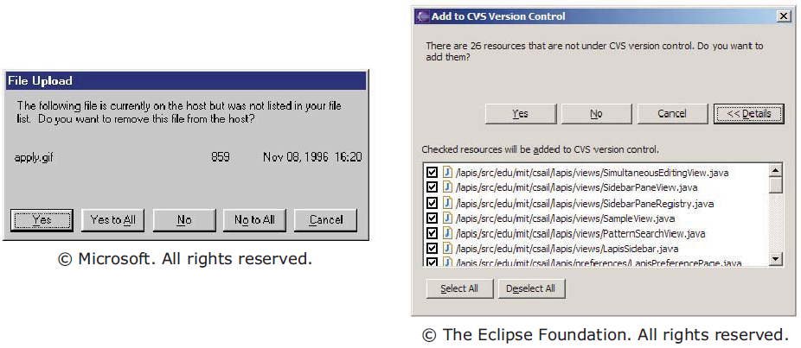
Aggregating questions

Slide 21
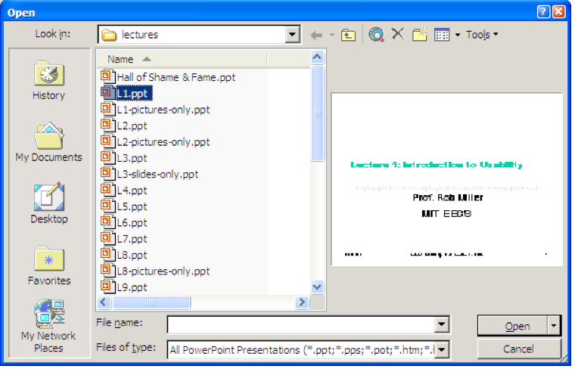
Anticipation
Anticipation means that a good design should put all needed information and tools within the user’s easy reach.

Slide 22
Pointing and steering

Slide 23
Fitts’s Law
One of the principles underlying the ergonomics of graphical user interface design
Named for Paul Fitts, a psychologist at Ohio State University
Fitts' model was originally formulated to project how quickly a human could point at a physical button, it turns out that the same set of rules governs how quickly someone can target an area on the screen with a mouse cursor.
Notes:
http://blogs.msdn.com/b/jensenh/archive/2006/08/22/711808.aspx

Slide 24
Fitts’s Law
It is a mathematical model of fine motor control which predicts how long it takes to move from one position to another as a function of the distance to and size of the target area.
The farthest away a target is, the longer it takes to acquire it with the mouse
The smaller a target is, the longer it takes to acquire it with the mouse
The inverse of both statements is true as well (closer and bigger targets can be more quickly acquired)
Notes:
http://blogs.msdn.com/b/jensenh/archive/2006/08/22/711808.aspx

Slide 25
Example
If you want to hit board with marker is it difficult or easy. Assume you are standing beside the last bench of the class.
If you want to hit a Duster with marker is it difficult or easy. Assume you are standing beside the last bench of the class.
If you want to hit a Duster with marker is it difficult or easy. Assume you are standing near the duster.

Slide 26
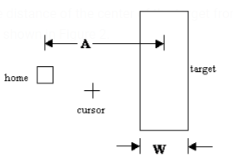

Fitts’s Law Formula
Time MT to move your hand to target of size W at distance A away is:
  MT is the movement time to hit the target
  a and b are experimentally determined constants, that are device dependent.
    a is the reaction time for getting your hand moving
  c is a constant of 0, 0.5 or 1
  A is the distance of the center of the target from the starting location
  W is the width of the target
MT = a + b log₂(2A/W + c)

Slide 27
Our interest in fits law is
Difficulty index
Index of difficulty (ID) = log₂(A/W + c)

Slide 28
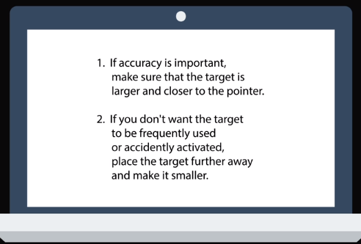
Implications of Fitts’s Law
Greater mouse distances mean an increased MT target acquisition time.
  Put the objects closer
  Make the objects bigger

Slide 29



some implications/ examples
Notes:
Most often used keys are larger.
You want the driver to access brake pedal more easily.
https://vimeo.com/200436363

Slide 30
What is the shortest distance for a mouse to move on the screen to perform an action?

Slide 31
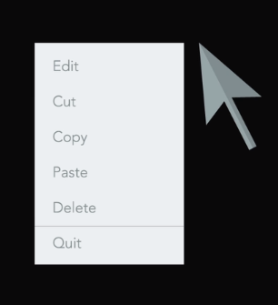
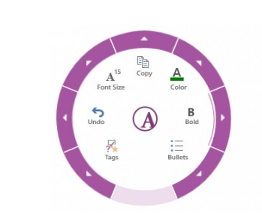
Pop up menu /Pie Menu
Notes:
That’s why the most important task are located on right click pop up menu.

Slide 32
What is another easy place for a pointer to move to?

Slide 33
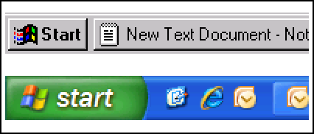
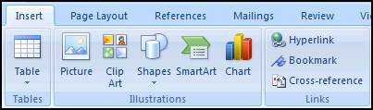
Mile‐High Menus & Magic Corners
Larger, labeled controls can be clicked more quickly

Slide 34
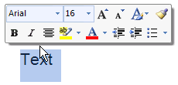

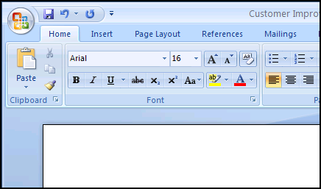
Examples
Mini Toolbar: Close to the cursor
Quick Access that's a mile high...
Magic Corner: Office Button in the upper‐left corner
Notes:
Pop-up menus better support immediate selection of interactive elements than dropdown menus as the user does not have to move the cursor from its current position. Therefore, graphical designs that allow the user to interact without moving help to reduce the 'travel time'.

Slide 35
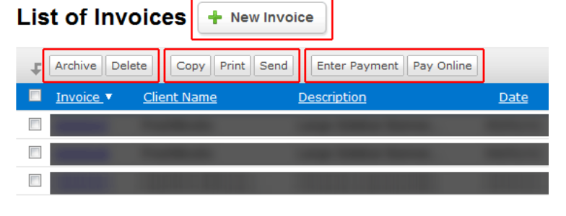
Place similar functionalities together.

Slide 36
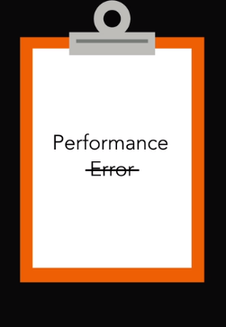
Using Fitts's Law will improve performance and reduce errors.

Slide 37
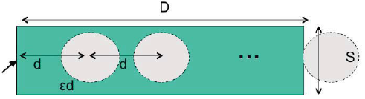
Steering tasks
Time T to move your hand through a tunnel of length D and width S is:
    T = a + b ( D/S)
Index of difficulty is linear, not logarithmic
  So steering is much harder than pointing
Thus cascading submenus are hard to use
Note:
D => A
S => W
Notes:
Wsdm2012.org

Slide 38
Improve mouse efficiency
Make frequently used targets big
Put targets used together near each other
Use screen corners and screen edges
Avoid steering tasks

Slide 39
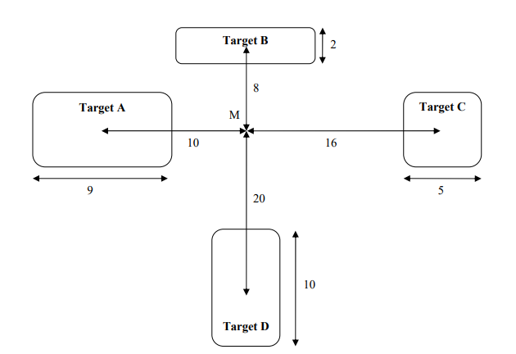
Exercise
Indicate giving reasons which target you think is fastest to reach with the mouse starting at location M. Assume that you can move your hand equally well in all directions, and that none of the targets are near a screen edge. Please include all calculations in your answer.

Slide 40
Keystroke Level Model (KLM)
Notes:
Reference: http://www.cs.loyola.edu/~lawrie/CS774/S06/homework/klm.pdf

Slide 41
Keystroke Level Model (KLM)
Used to measure user performance time with interactive systems.
KLM is best suited to evaluate time specific tasks that requires less time for completion.
A method that can be used by individuals or companies seeking ways to estimate the time it takes to complete simple data input tasks using a computer and mouse.

Slide 42
Keystroke Level Model (KLM)
It is not necessary to have an implemented or mocked-up design; the KLM requires only that the user interface be specified in enough detail to dictate the sequence of actions required to perform the tasks of interest.
The actions are termed keystroke level if they are at the level of actions like pressing keys, moving the mouse, pressing buttons, and so forth, as opposed to actions like "log onto system“.

Slide 43
Keystroke Level Model (KLM) - operators
The basic actions are called operators.
  Keystroke
  Button press or release with mouse
  Point with mouse
  Draw line with mouse
  Home hands between mouse and keyboard
  Mentally prepare
Notes:
The first predictive model was the keystroke level model (proposed by Card, Moran & Newell, “The
Keystroke Level Model for User Performance Time with Interactive Systems”, CACM, v23 n7, July 1978).
This model seeks to predict efficiency (time taken by expert users doing routine tasks) by breaking down the
user’s behavior into a sequence of the five primitive operators shown here.
Most of the operators are physical – the user is actually moving their muscles to perform them. The M
operator is different – it’s purely mental (which is somewhat problematic, because it’s hard to observe and
estimate). The M operator stands in for any mental operations that the user does. M operators separate the
task into chunks, or steps, and represent the time needed for the user to recall the next step from long-term
memory.

Slide 44
Keystroke Level Model (KLM) - operators
The basic actions are called operators.
  Point with mouse
    Moving from start point to end point.
  Draw line with mouse
    Follows a boundaried path
    Needs precision.
Notes:
The first predictive model was the keystroke level model (proposed by Card, Moran & Newell, “The
Keystroke Level Model for User Performance Time with Interactive Systems”, CACM, v23 n7, July 1978).
This model seeks to predict efficiency (time taken by expert users doing routine tasks) by breaking down the
user’s behavior into a sequence of the five primitive operators shown here.
Most of the operators are physical – the user is actually moving their muscles to perform them. The M
operator is different – it’s purely mental (which is somewhat problematic, because it’s hard to observe and
estimate). The M operator stands in for any mental operations that the user does. M operators separate the
task into chunks, or steps, and represent the time needed for the user to recall the next step from long-term
memory.

Slide 45
Mental Preparation
M merely represents the time to prepare mentally for the next step in the method
Highly variable from situation to situation or person to person.
Users are engaged in routine operation of a computer, there are pauses in the stream of actions that are about a second long and that are associated with routine acts such as remembering a filename or finding something on the screen.
The M operator is intended to represent this routine thinking.

Slide 46
Specific suggestions for activities that take an M
Initiating a task
Retrieving a chunk from memory (recalling a DOS command)
Finding something on the screen (before every pointing operator)
Thinking of a task parameter (before entering an input from the keyboard)
Notes:
Initiating a task. The user has to pause and make a definite decision about what the task is, and what should be
done. Thus users often pause before emitting a sequence of actions; this pause should be routinely represented by an
M.
Making a strategy decision. If there is more than one way to proceed, and the decision is not obvious or well
practiced, but is important, the user has to stop and think.
Retrieving a chunk from memory. A chunk is a familiar unit such as a file name, command name or
abbreviation. For example, if the user wants to list the contents of directory foo, they need to retrieve two chunks,
dir and foo, each of which takes an M.
Finding something on the screen. The user must pause and scan the screen for an item that they do not already
know or whose location on the screen they do not already know from practice.
Thinking of a task parameter. The user must either remember or otherwise access a task parameter value.
Verifying that a specification or action is correct. Before users signal the system to proceed, they often pause
and check their entry. For example, users often stop and examine a command before hitting return, or check a
dialog box before clicking on the OK, or that a destination folder is reverse-video before releasing the mouse button.
Some useful conventions. Models often contain certain sequences of actions which should be represented in a
consistent way. Some suggestions:
• The values for task parameters have to be explicitly obtained in a step.
• Pointing to an object on the screen should be preceded by a mental operator to locate the object.
• If something on the screen changes in response to user input, there should be a step to verify that the desired
result appeared.

Slide 47
General suggestions for working with Ms
Consistency is key. Consistency in M placement is more important than absolute accuracy - be sure that you follow the same rules or philosophy in assigning Ms to each alternative design.
Number of Ms is more important than placement. Sometimes it's pretty clear what pieces of thinking the user might have to do, but the exact times or sequence in which they do these piece might be very unclear.

Slide 48
There is a standard set of operators for use in the KLM, whose execution times have been estimated from experimental data.

Slide 49
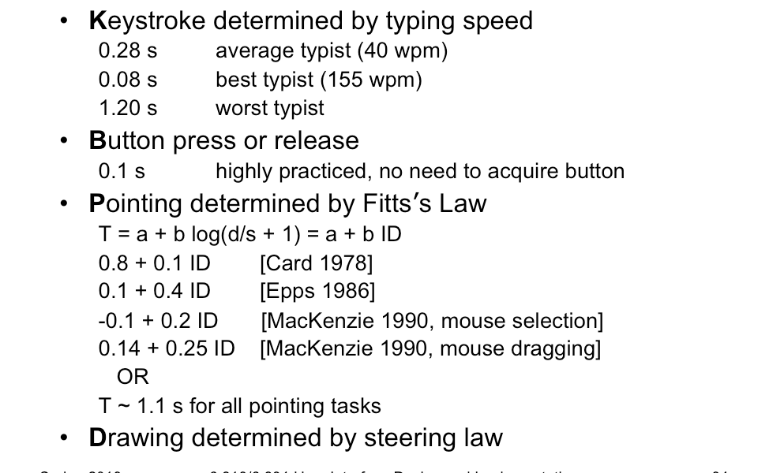
Estimated operator Times
Notes:
Button Mouse buttons are faster than keystrokes because there
are far fewer mouse buttons to choose from (reducing the user’s reaction time) and they’re right under the
user’s fingers (eliminating lateral movement time), so mouse buttons should be faster to press. Note that a
mouse click is a press and a release, so it costs 0.2 seconds in this model.
Pointing time can be modelled by Fitts’s Law, but now we’ll actually need numerical parameters for it.
Empirically, you get a better fit to measurements if the index of difficulty is log(D/S+1); but even then,
differences in pointing devices and methods of measurement have produced wide variations in the parameters
(some of them seen here). There’s even a measurable difference between a relaxed hand (no mouse buttons
pressed) and a tense hand (dragging). Also, using Fitts’s Law depends on keeping detailed track of the location
of the mouse pointer in the model, and the positions of targets on the screen. An abstract model like the
keystroke level model dispenses with these details and just assumes that Tp ~ 1.1s for all pointing tasks. If
your design alternatives require more detailed modeling, however, you would want to use Fitts’s Law more
carefully.
Drawing time, likewise, can be modeled by the steering law: T = a + b (D/S).

Slide 50
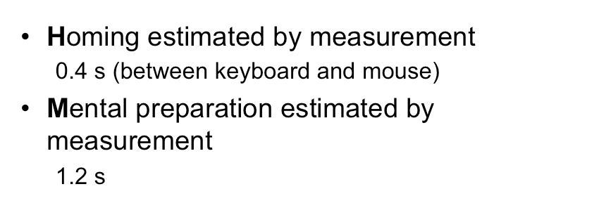
Estimated operator times
Notes:
Homing time is estimated by a simple experiment in which the user moves their hand back and forth from the
keyboard to the mouse.
Finally we have the Mental operator. The M operator does not represent planning, problem solving, or deep
thinking. None of that is modeled by the keystroke level model. M merely represents the time to prepare
mentally for the next step in the method – primarily to retrieve that step (the thing you’ll have to do) from
long-term memory.
W(t) - Waiting for the system to respond (time t must be determined). This is the time that the user must wait on the system before he or she can proceed. Notice that it is not necessarily the same as the time required by the system, because the user may be able to overlap other activities while the system is working.
In many cases with modern computers, the waiting time is essentially negligible. In other cases, such as a database retrieval or website usage, the delay might be substantial, but still the same regardless of which interface design is under consideration. In such cases, it may not be necessary to include this operator, either because it takes near-zero time, or it has the same value in all of the alternative designs, and so affects only the absolute, not the relative, task times.

Slide 51
Estimated operator times
K = 0.28s
B = 0.1s
P = 1.1s
D = 1.1s (commonly)
H = 0.4s
M = 1.2s

Slide 52
KLM Analysis - Method
Choose one or more representative task scenarios.
Have the design specified to the point that keystroke-level actions can be listed for the specific task scenarios.
For each task scenario, figure out the best way to do the task, or the way that you assume users will do it.
List the keystroke-level actions
Insert mental operators for when user has to stop and think.
Look up the standard execution time to each operator. Add up the execution times for the operators.
The total of the operator times is the estimated time to complete the task.
Notes:
Here’s how to create a keystroke level model for a task.
First, you have to focus on a particular method for doing the task. Suppose the task is deleting a word in a text
editor. Most text editors offer a variety of methods for doing this, e.g.: (1) click and drag to select the word,
then press the Del key; (2) click at the start and shift-click at the end to select the word, then press the Del key;
(3) click at the start, then press the Del key N times; (4) double-click the word, then select the Edit/Delete
menu command; etc.
Next, encode the method as a sequence of the physical operators: K for keystrokes, B for mouse button presses
or releases, P for pointing tasks, H for moving the hand between mouse and keyboard, and D for drawing tasks.
Next, insert the mental preparation operators at the appropriate places, before each chunk in the task. Some
heuristic rules have been proposed for finding these chunk boundaries.
Finally, using estimated times for each operator, add up all the times to get the total time to run the whole
method.

Slide 53
Assumptions
The user is an expert in the domain and system being analyzed.
The user will start with her hands on the keyboard or stated otherwise.
The user is not interrupted during the tasks.
The user is familiar with the hardware.
The user's system has essentially instantaneous response time (or you will include a "Wait" operator).
The user is an average typist (and thus will take 0.28 seconds to press a key).
Notes:
http://www.cs.loyola.edu/~lawrie/CS774/S06/homework/klm.pdf
https://enacademic.com/dic.nsf/enwiki/910192

Slide 54
Scenario 1 :
Deleting a file (Drag to Trash Can)
One file is to be deleted
File icon is visible and can be pointed to
Trash can icon is visible and can be pointed to
Cursor must end up in the original window that the file icon was in
Hand starts and ends on mouse
User is average non-secretary typist.

Slide 55
Action Sequence
1. point to file icon
2. press and hold mouse button
3. drag file icon to trash can icon
4. release mouse button
5. point to original window

Slide 56
Operator Sequence
1. point to file icon P
2. press and hold mouse button B
3. drag file icon to trash can icon P
4. release mouse button B
5. point to original window P
Total time = 3P + 2B = 3*1.1 + 2*.1 = 3.5 sec
Put mental in above task.

Slide 57
Scenario 1 : Deleting a file (Method B)
In the new design, the procedure we intend people to use is to first select the file to be deleted, and then select DELETE on the FILE menu.

Slide 58
Action Sequence
1. point to file icon
2. click mouse button
3. point to file menu
4. click mouse button
5. point to DELETE item
6. click mouse button
7. point to original window

Slide 59
Operator Sequence
1. point to file icon P
2. click mouse button BB
3. point to file menu P
4. click mouse button BB
5. point to DELETE item P
6. click mouse button BB
7. point to original window P
Total time = 4P + 6B = 4*1.1 + 6*.1 = 5.0 sec
Put mental in above task.

Slide 60
Power key variation on new design.
We will add a "power key" for the delete file operation, such as ctrl + T (T for "trash"). For the sake of illustration, we assume that user uses both hands to type the power key, and so will have to move the hand from the mouse to the keyboard. The general procedure is now to select the file to be deleted, then hit the command keystroke for delete. He will move his hand back to mouse.

Slide 61
Operator sequence
1. point to file icon P
2. click mouse button BB
3. move hand to keyboard H
4. hit command key KK
5. move hand back to mouse H
Total time = P + 2B + 2H + 2K = 1.1 + .2 + .8 + .56 = 2.66 sec
Put mental in above task.

Slide 62
Example – deleting a word
Shift-click selection
  Move pointer to the start of word
  Click at the start of word
  Move pointer to the end of word
  Move hand to shift key
  Press shift
  Click to select
  Move hand to the Del key
  Press key
P
B B
P
H
K
B B
H
K
Total = 2P + 4B + 2K + 2H
= 2(1.1) + 4(0.1) + 2(0.28) + 2(0.4)
= 3.96 seconds

Slide 63
Example – deleting a word
For initiating the task
Shift-click selection
  Move pointer to the start of word
  Click at the start of word
  Move pointer to the end of word
  Move hand to shift key
  Press shift
  Click to select
  Move hand to the Del key
  Press key
M
P M
B B
P M
H
K
B B
H
K
Total = 3M + 2P + 4B + 2K + 2H
= 3(1.2) + 2(1.1) + 4(0.1) + 2(0.28) + 2(0.4)
= 7.56 seconds

Slide 64
Example: Deleting a Word using Del Key
??
Total = ??
Notes:
Here are keystroke-level models for two methods that delete a word.
The first method clicks at the start of the word, shift-clicks at the end of the word to highlight it, and then
presses the Del key on the keyboard. Notice the H operator for moving the hand from the mouse to the
keyboard. That operator may not be necessary if the user uses the hand already on the keyboard (which
pressed Shift) to reach over and press Del.
The second method clicks at the start of the word, then presses Del enough times to delete all the characters in
the word.

Slide 65
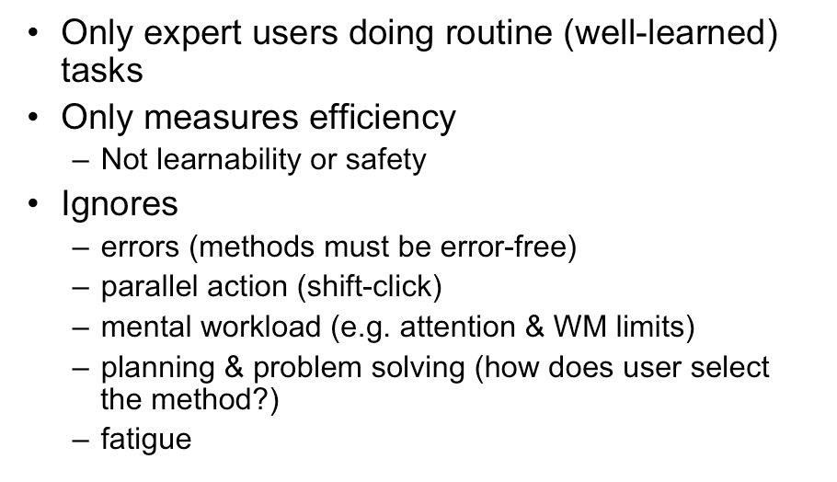
Limitations of KLM
Notes:
Keystroke level models have some limitations -- we’ve already discussed the focus on expert users and
efficiency. But KLM also assumes no errors made in the execution of the method, which isn’t true even for
experts. Methods may differ not just in time to execute but also in tendency of errors, and KLM doesn’t
account for that.
KLM also assumes that all actions are serialized, even actions that involve different hands (like moving the
mouse and pressing down the Shift key). Real experts don’t behave that way; they overlap operations.
KLM also doesn’t have a fine-grained model of mental operations. Planning, problem solving, different levels
of working memory load can all affect time and error rate; KLM lumps them into the M operator.

Slide 66
Activity
In Microsoft word, there is a menu of EDIT, after clicking on it a drop down menu occurs, we have to select FORMAT Option from it. A cascaded menu will appear. Choose BOLD from it. The task is to select Bold format and then write HCI.
Assumptions:
  Users hands are on keyboard as he was writing a word and pointer is somewhere on the screen. Microsoft word is maximized.

Slide 67
Steps:
M+H+MP+2B+MP+2B+D+MP+2B+H+M+3K

